Slide 1

Physical Computing
Lesson One

Slide 2
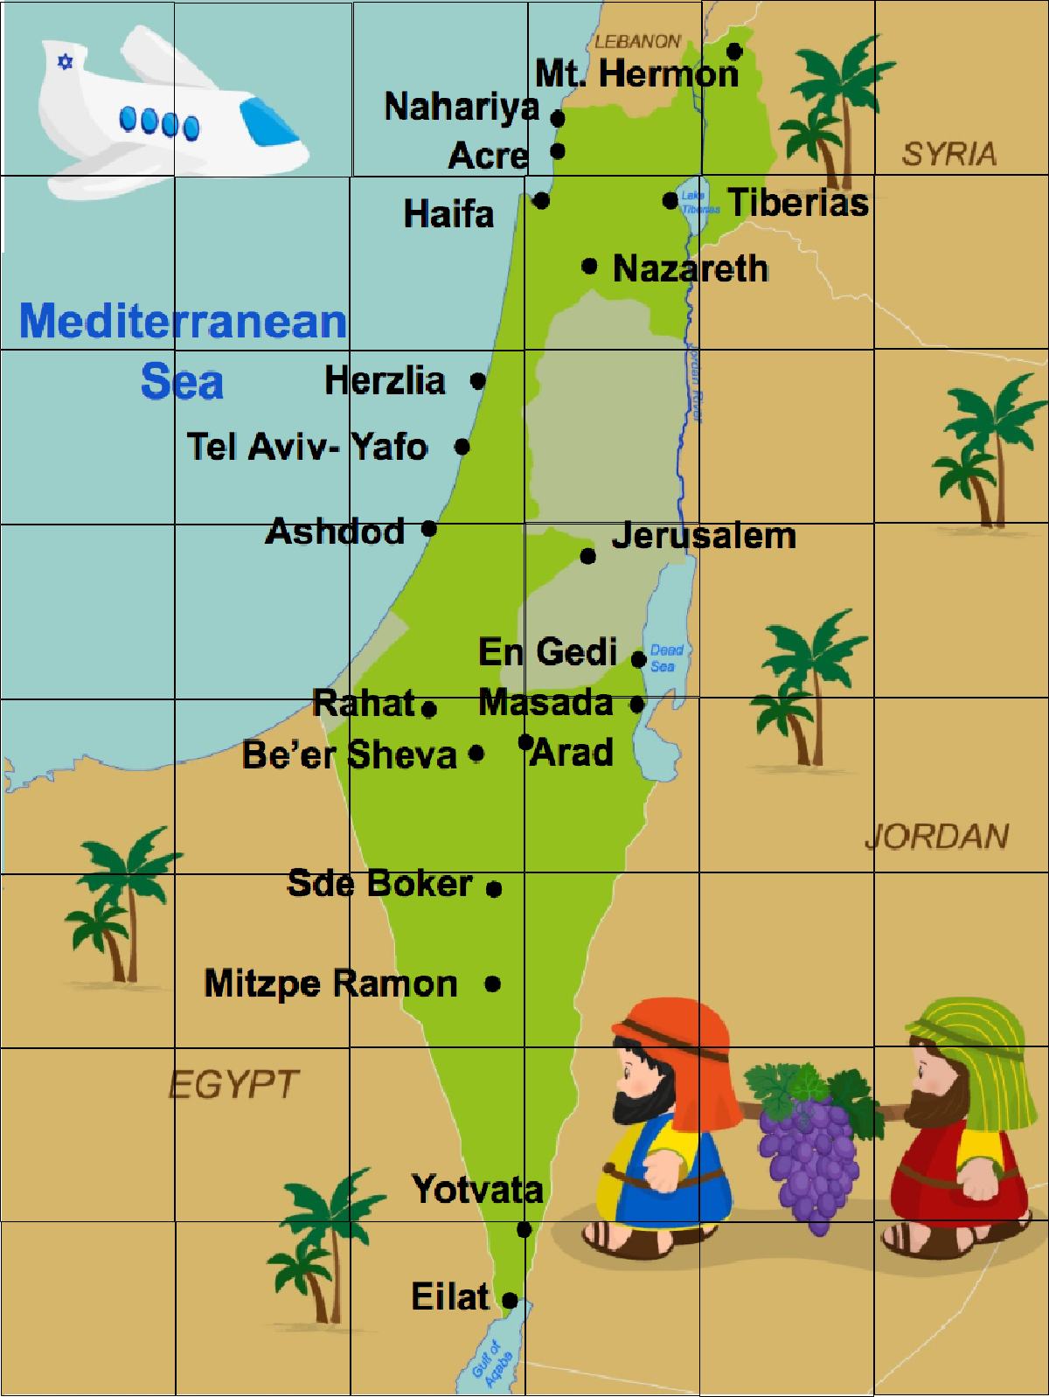



Where do you think my car is going?

Slide 3
Did you follow my car to Jerusalem?

Slide 4
Can you give my car directions to Mt Hermon?

Slide 5
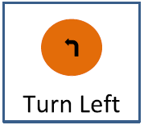
Which way did you find to Mt Hermon?
or
Which way is faster?

Slide 6
EXTENSION
Is there another way that we can write this?
F
F
F
F
R
F

Slide 7
EXTENSION
How would you get from Sde Boker to Herzlia?
L
F

